Slide 1


Content Management Project for tourism agency
Done by: Nour Eldeen, Ahmed mahdy, Khaled nader and Ramez nabil
Supervised by: Dr.Essam Eliwa

Slide 2
Introduction
The web application is created to allow clients to view and book packages and to track their date. Also if users would like to check for a certain hotel's availability within a time frame which the user chooses. Furthermore, The web application lets the support center operator deal with guests and users enquiries about the trips , packages and hotels reservations.

Slide 3
Objectives
Guests/Users successfully book desired packages/hotels and track it's progress remotely, And being able to submit queries/comments on the reserved package/hotel.
Admin can manage the website’s content by adding, removing or editing hotels and packages and such.
Support Center Operator can reply to customer’s inquiries and is responsible for sending the latest news.

Slide 4
User problem statement
Being able to correctly reserve the desired package/hotel without risking conflict or loss of data due to it being stored on paper forms, And being able to reserve without being present at the reservation office.

Slide 5
General constraints
A user should have a reliable internet connection .
A user should have a bank account with sufficient credit to book the package/hotel.
An admin should be aware of the business context .
The support center operator should reply to every enquiry requested by clients .

Slide 6



Functional Requirements
Admin can edit , add and remove hotels/packages.
Admin can add new articles to the website’s blog.
Admin can modify image gallery in hotels, packages and main page.
Guest/User can register to have an account on the website to gain access to it’s features.
Users can track their reservation’s status.
Users can send inquiries regarding reservations.
Support operator can respond to inquiries regarding reservations.
Support operator can send the latest news to the registered users.

Slide 7
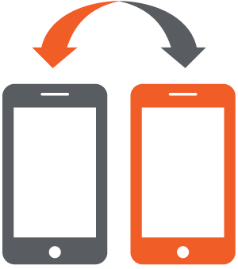



Non-functional requirements
Security
Portability
Reliability
Maintainability
The system will be secured by encrypting the username , password and the bank account of the client.
The application shall work on:
FireFox
Google Chrome
Opera
Internet Explorer
Safari
The system shall be designed to be error free and taking in consideration to secure the sensitive data of the client such as bank account number.
The system ensures ease of maintainability through the implementation of MVC design pattern. It should be easy to maintain to minimize the amount of changes that would be done to the code.

Slide 8
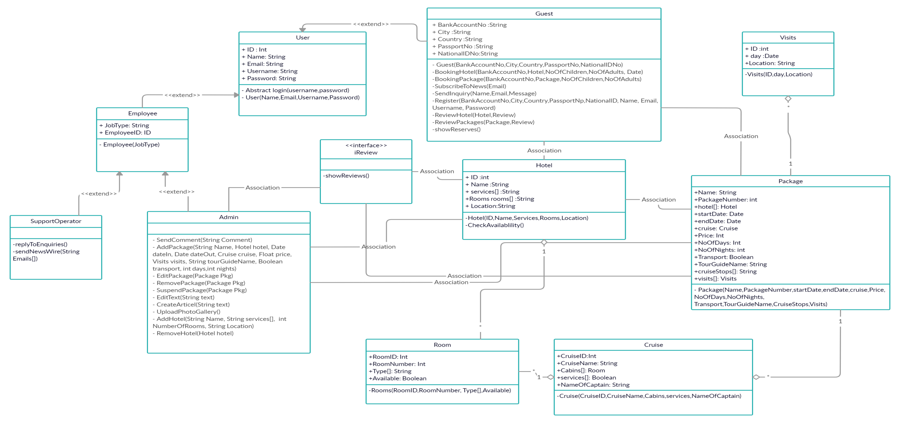
Class Diagram

Slide 9
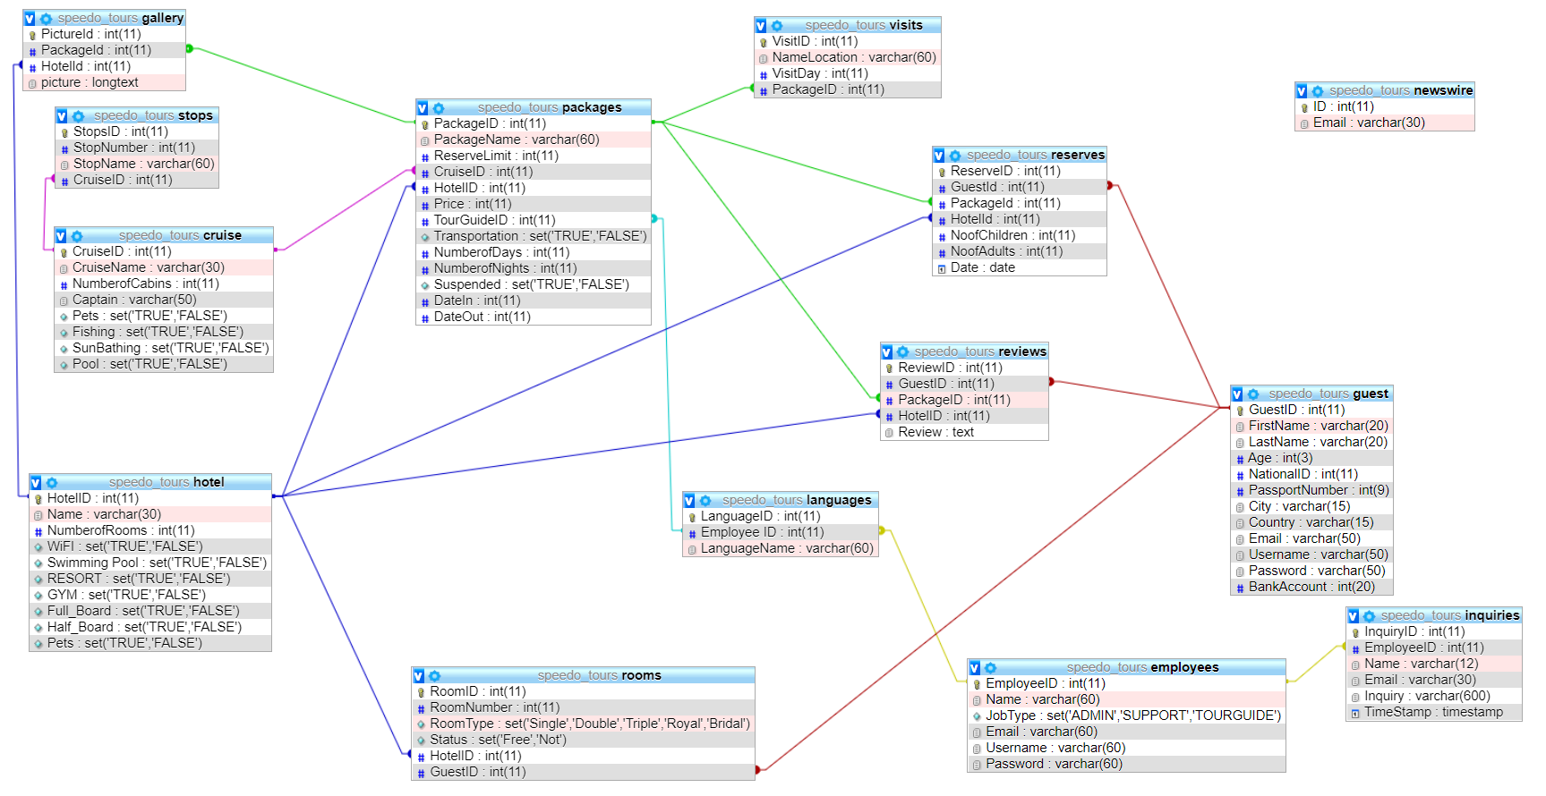
Database Diagram

Slide 10
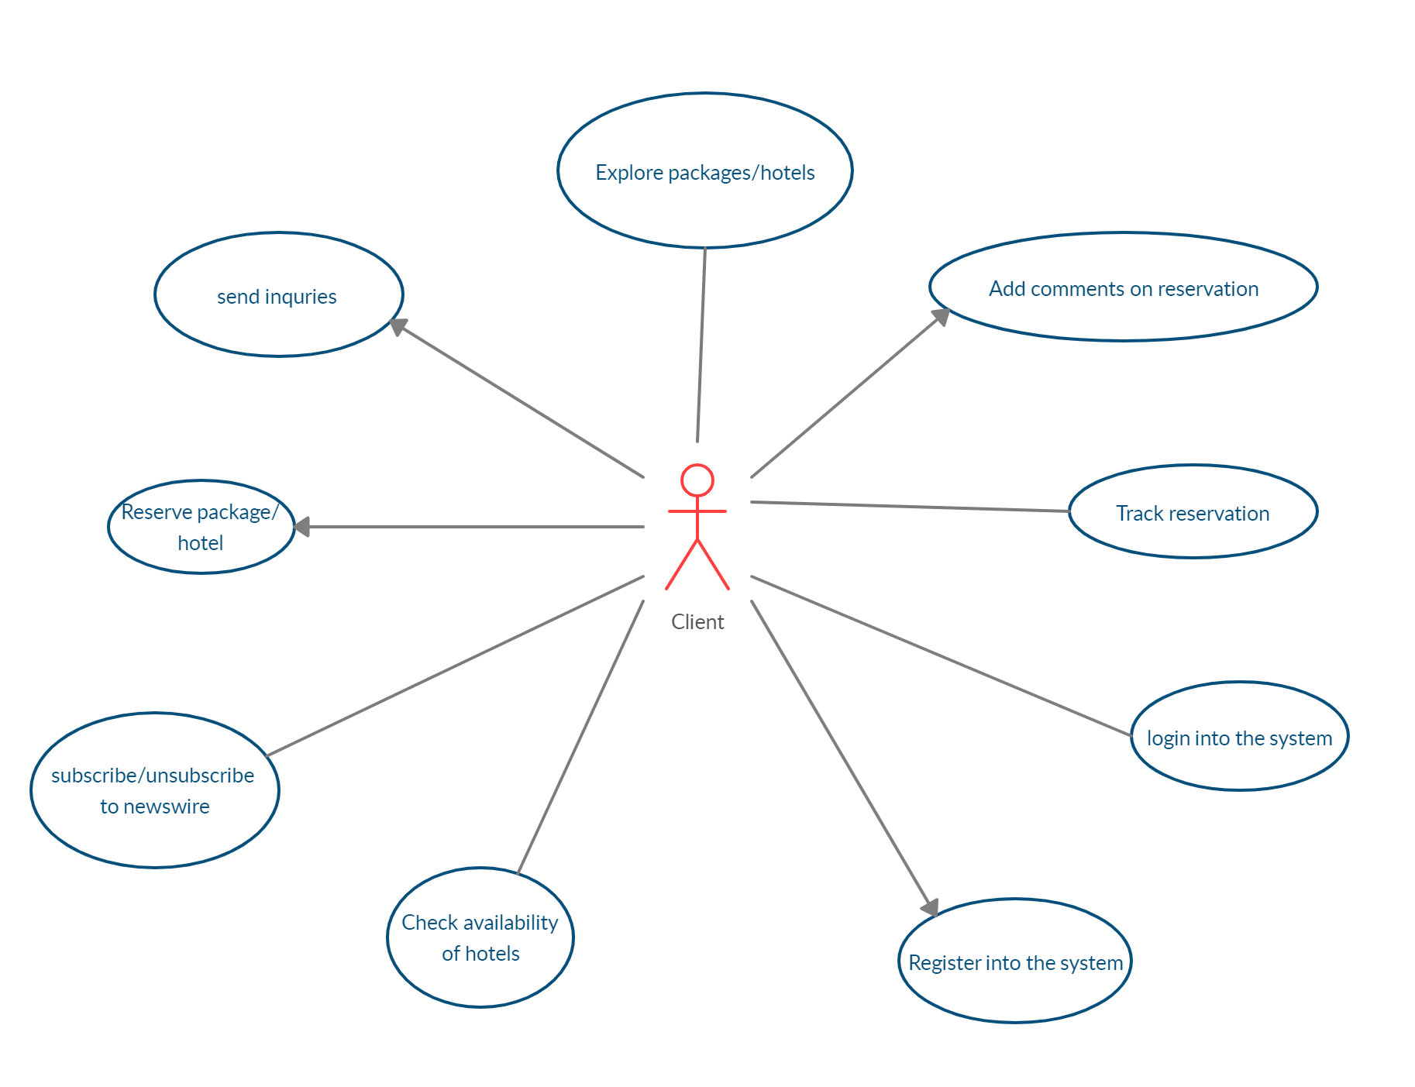
Use Case Diagram part 1

Slide 11
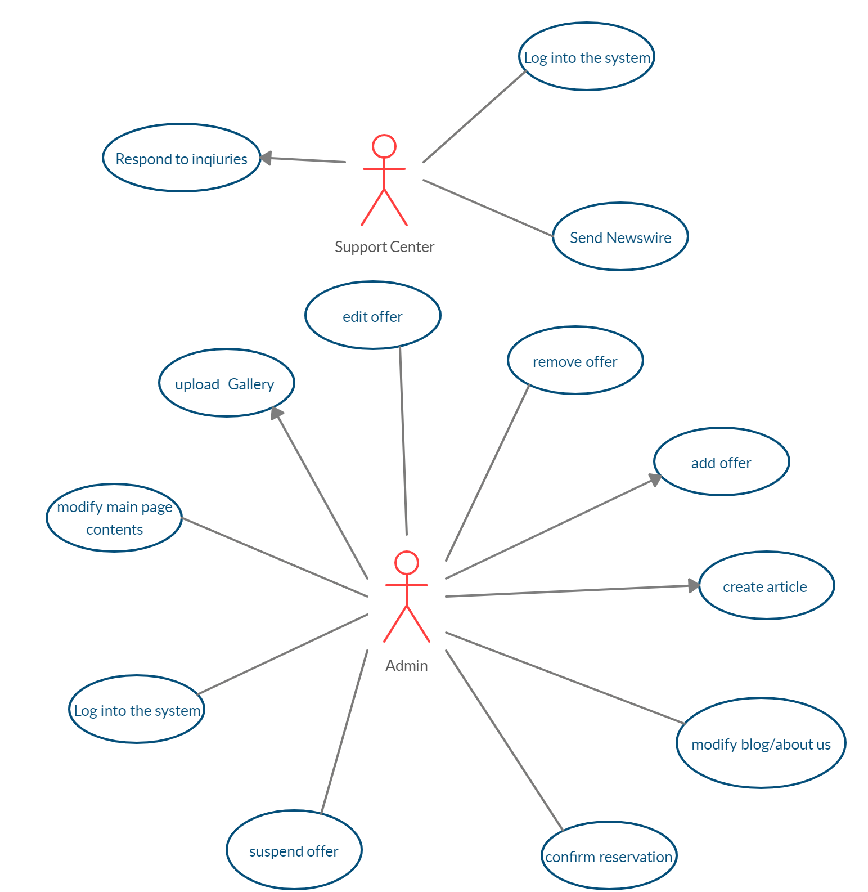
Use Case Diagram part 2

Slide 12
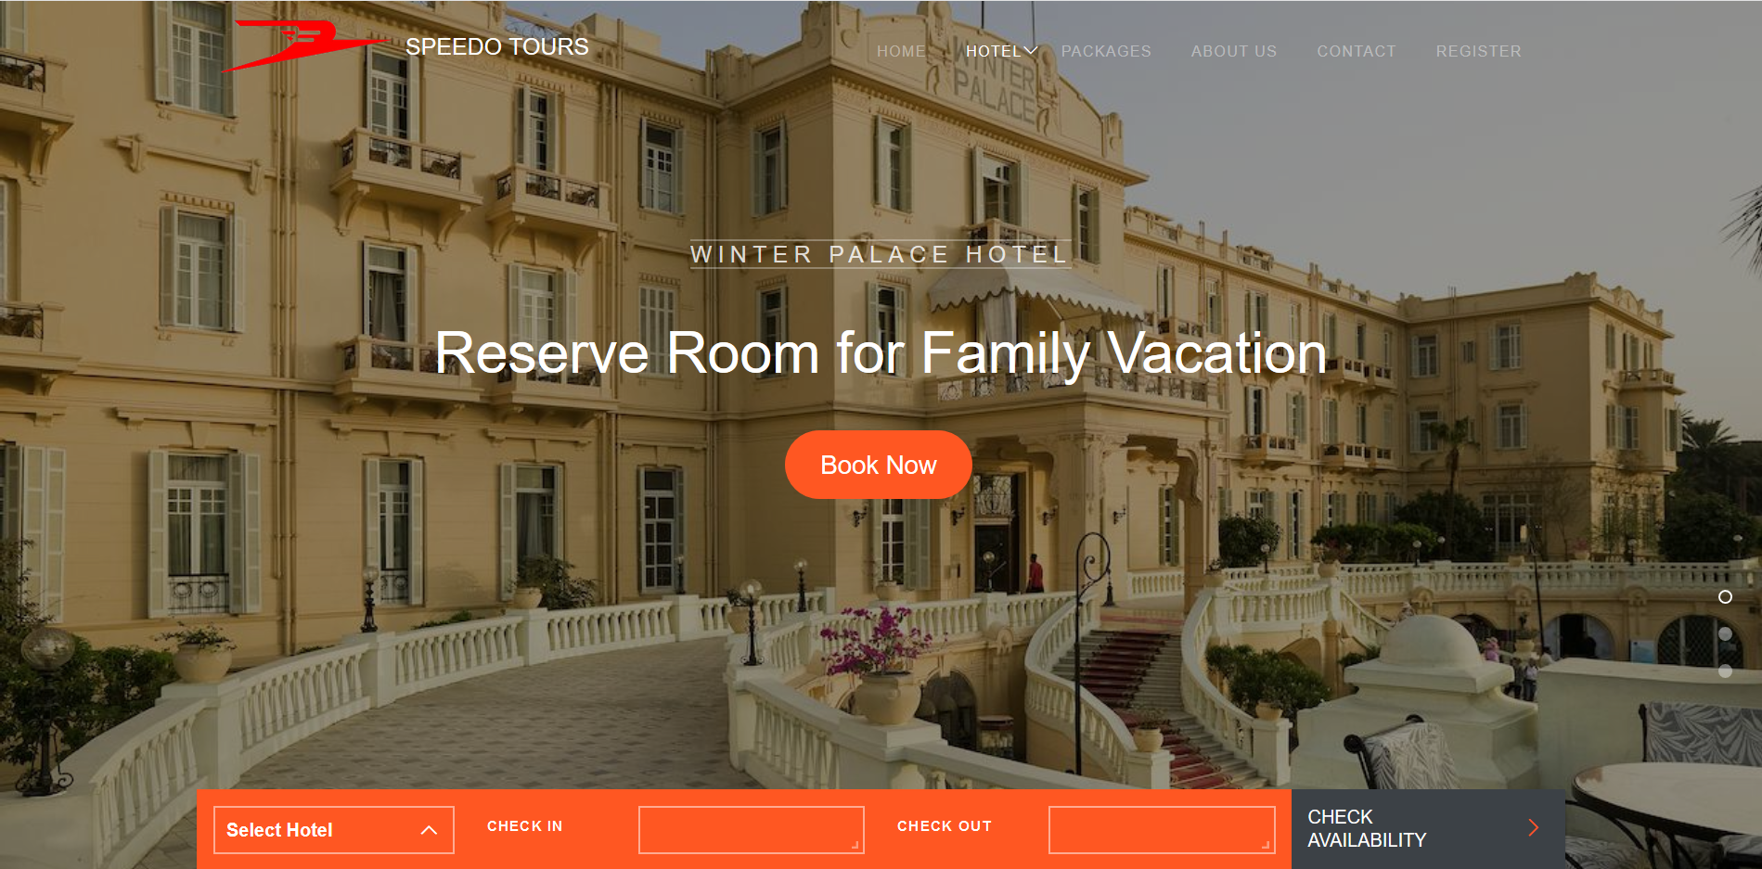
Frames (GUI)

Slide 13
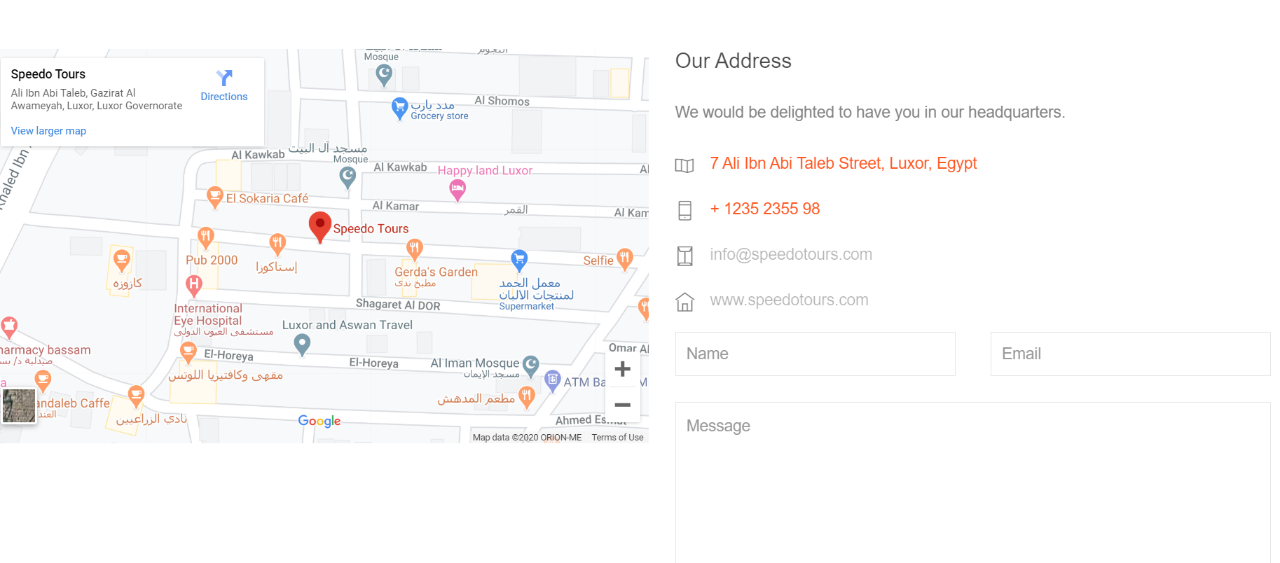
Frames (GUI)

Slide 14
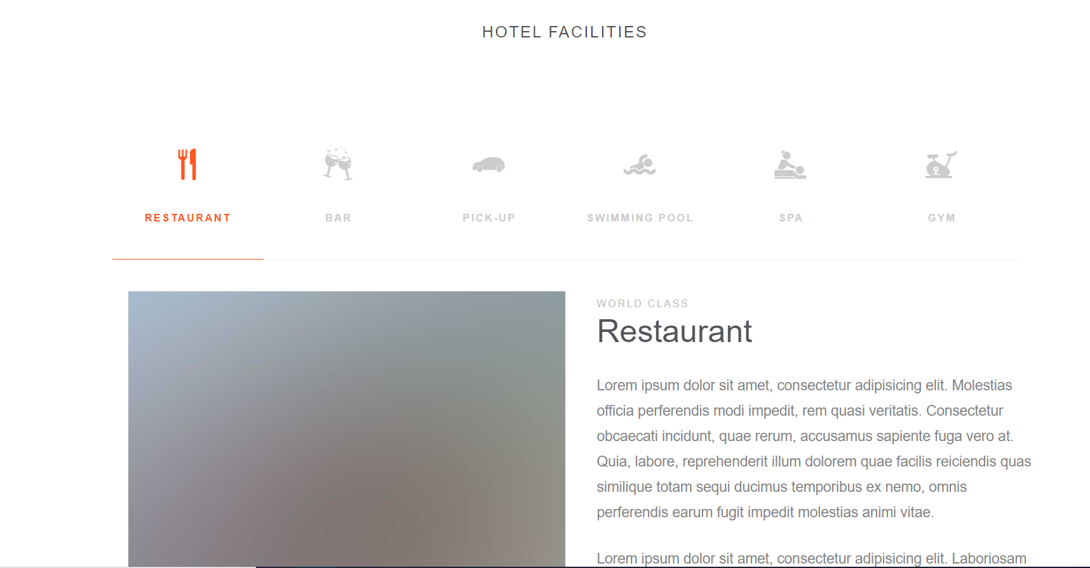
Frames (GUI)

Slide 15
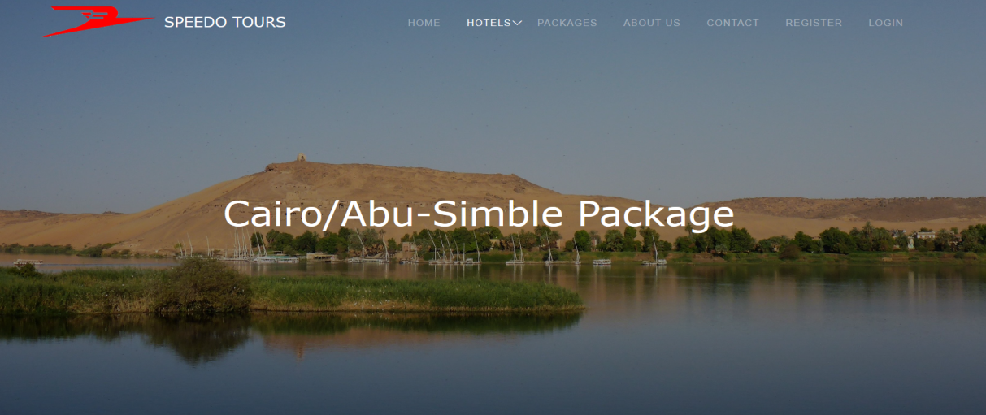
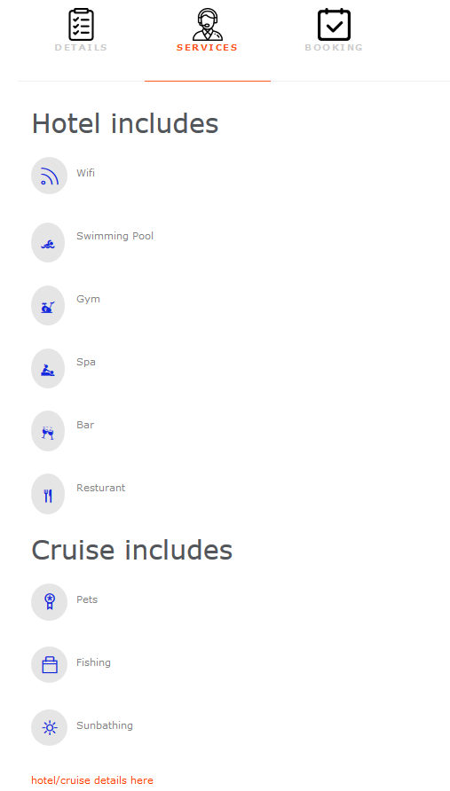
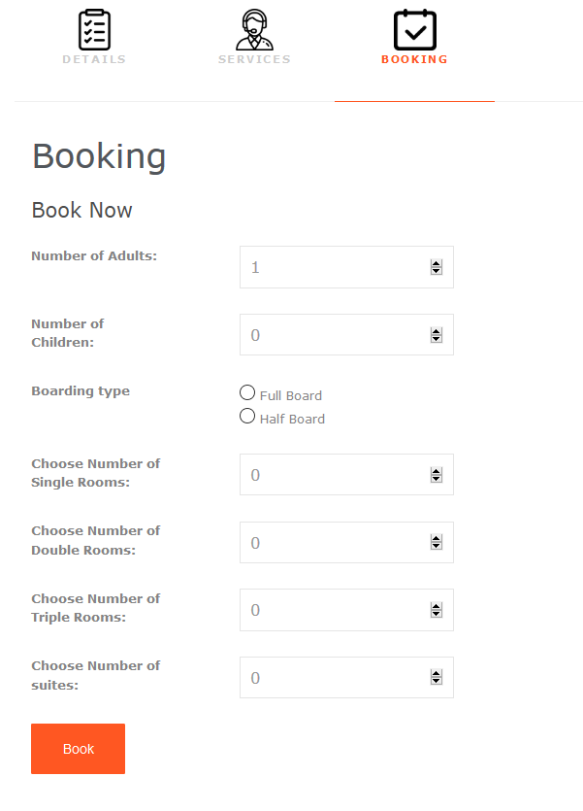
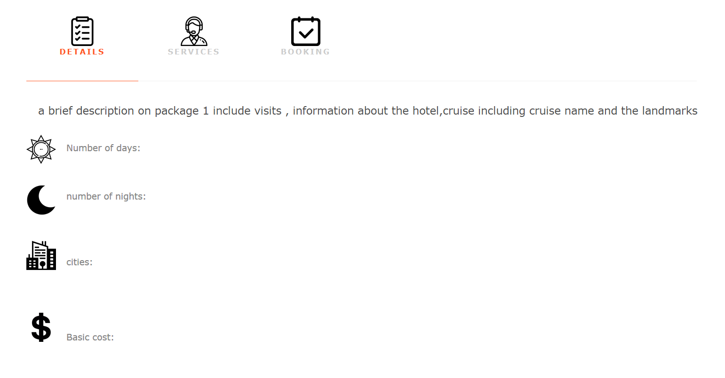
Frames (GUI)

Slide 16
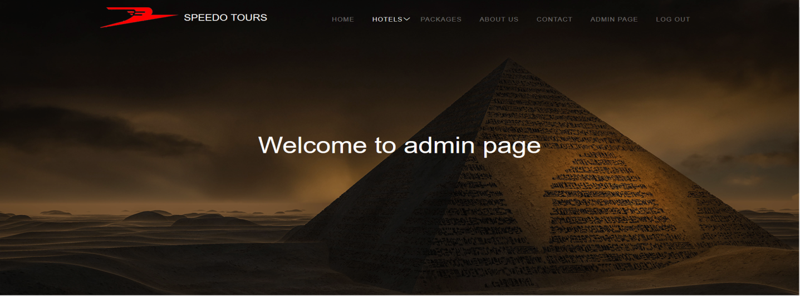
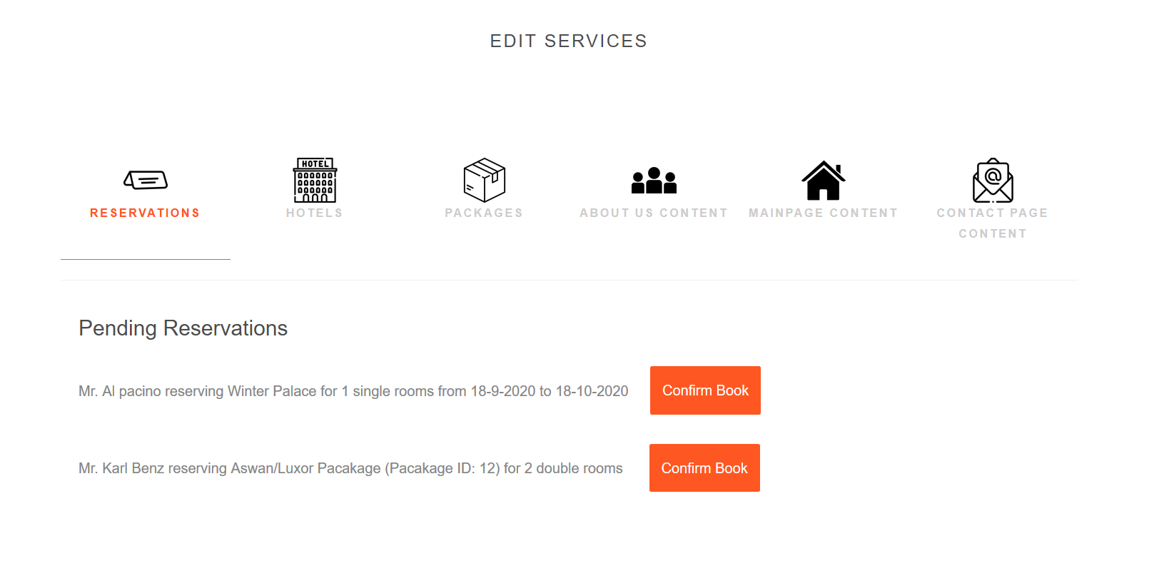
Frames (GUI)

Slide 17
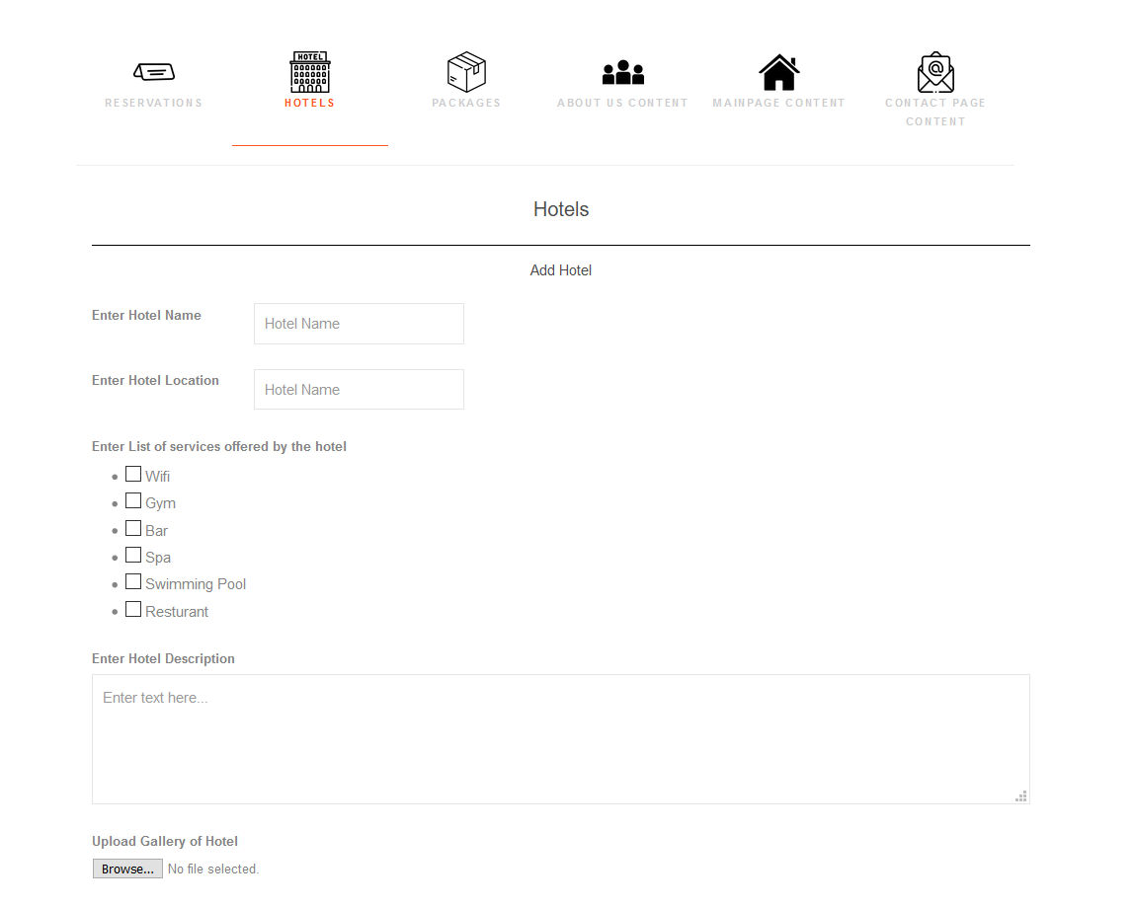
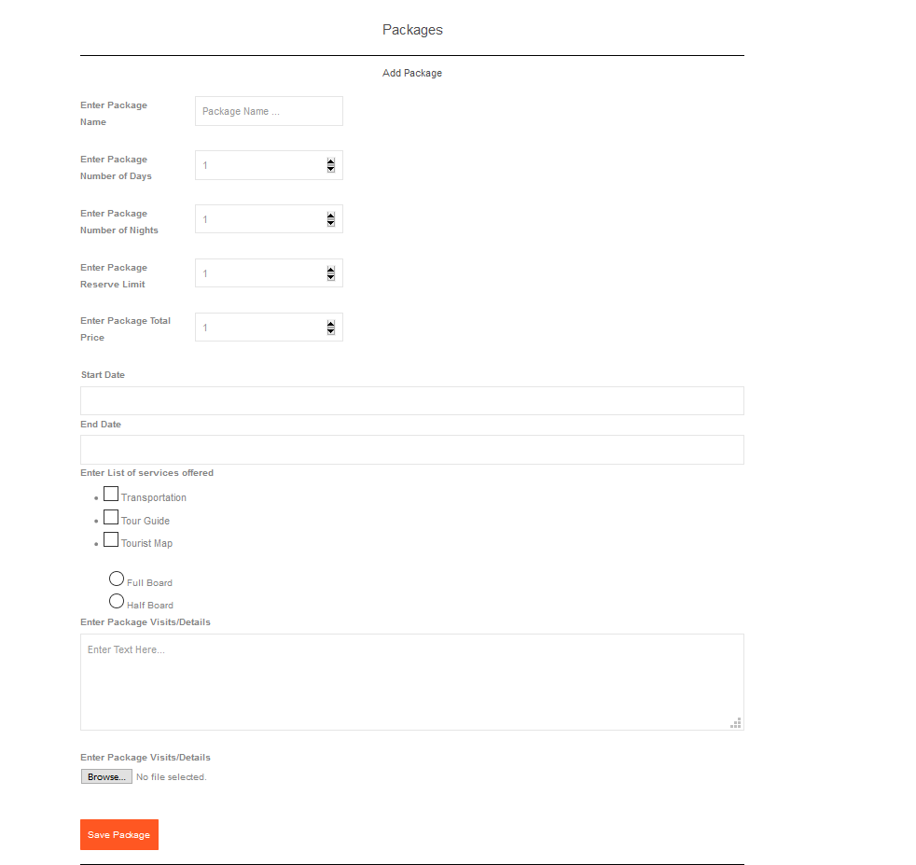
Frames (GUI)

Slide 18
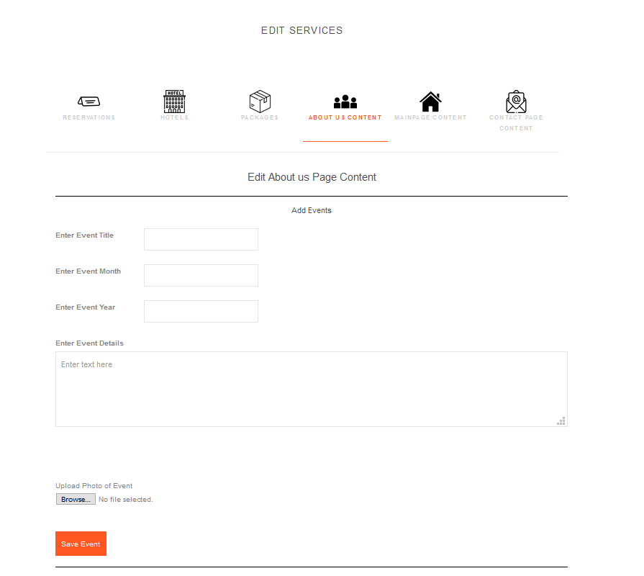
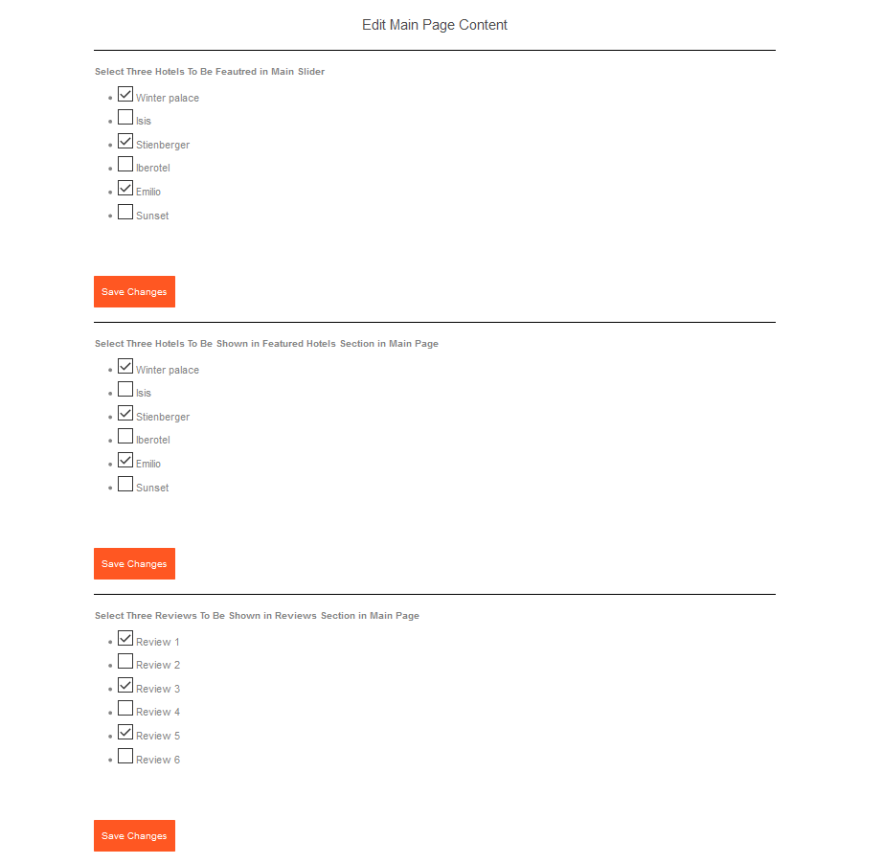
Frames (GUI)

Slide 19
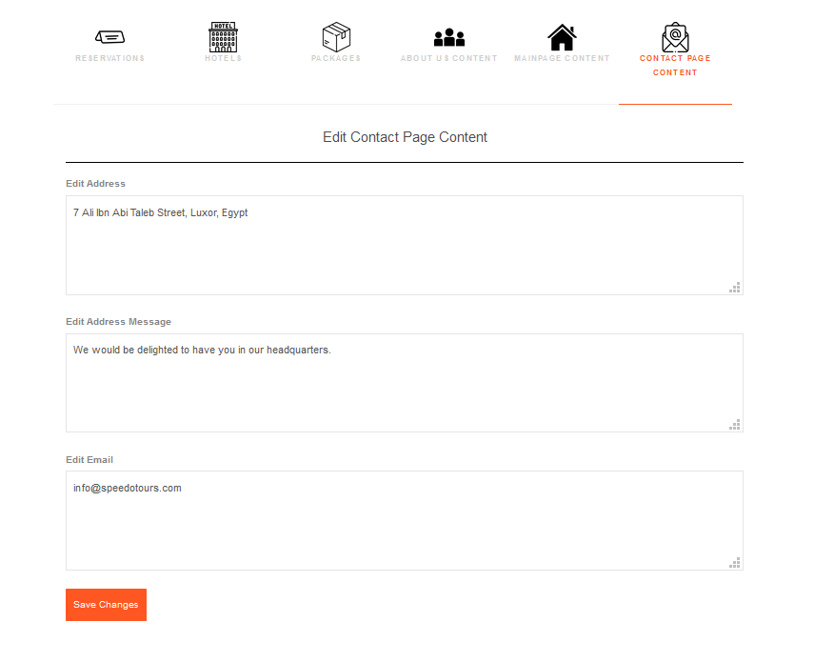
Frames (GUI)

Slide 20
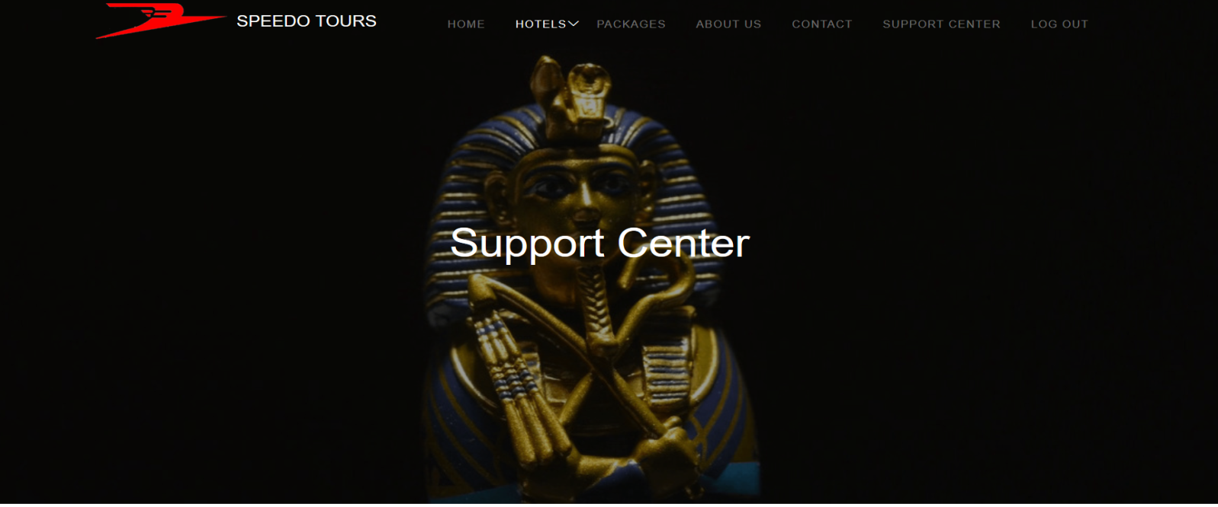
Frames (GUI)

Slide 21
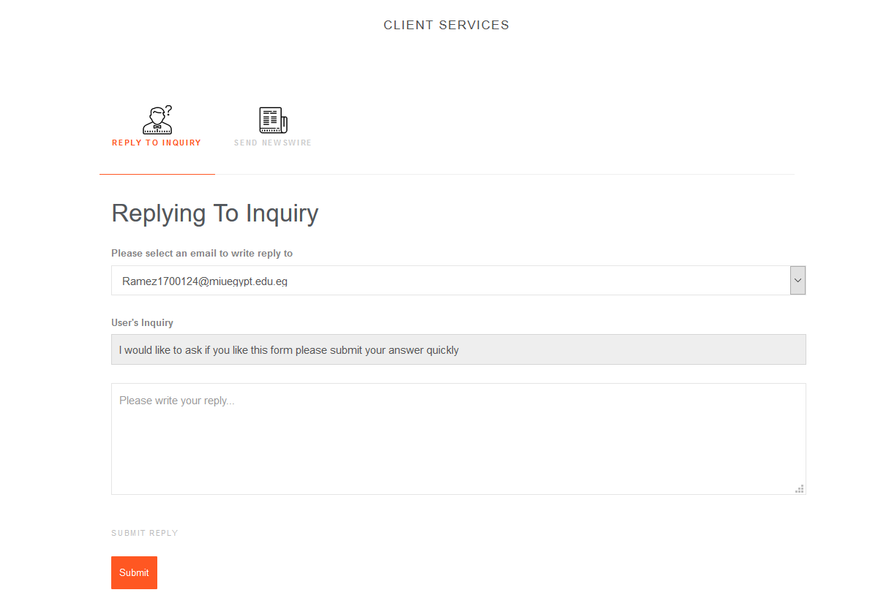
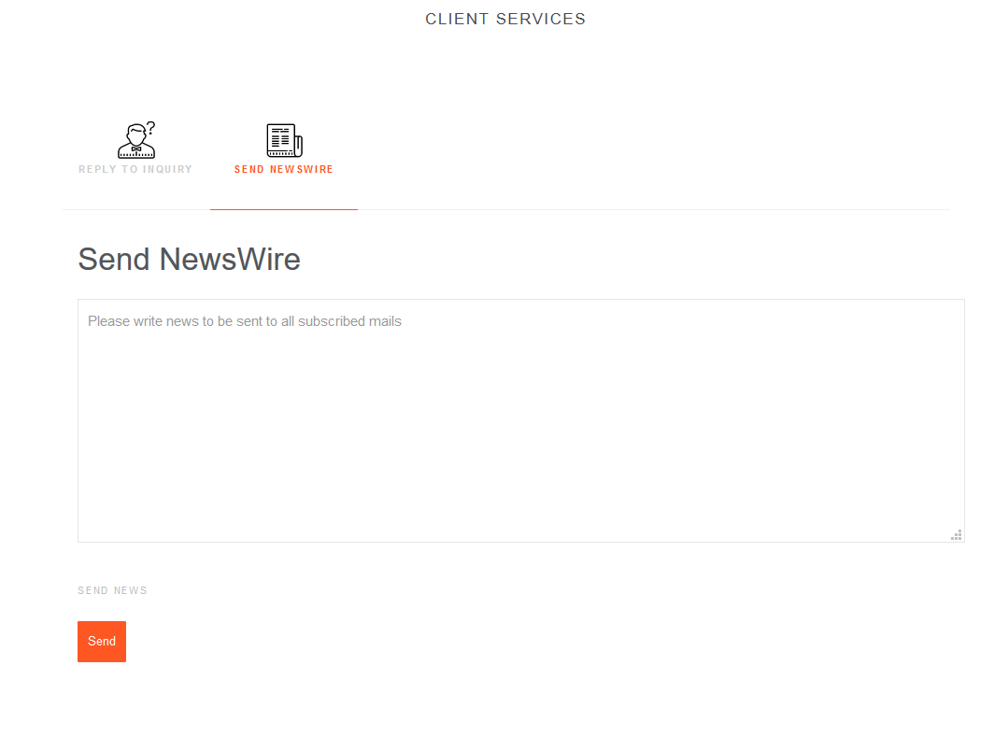
Frames (GUI)

Slide 22
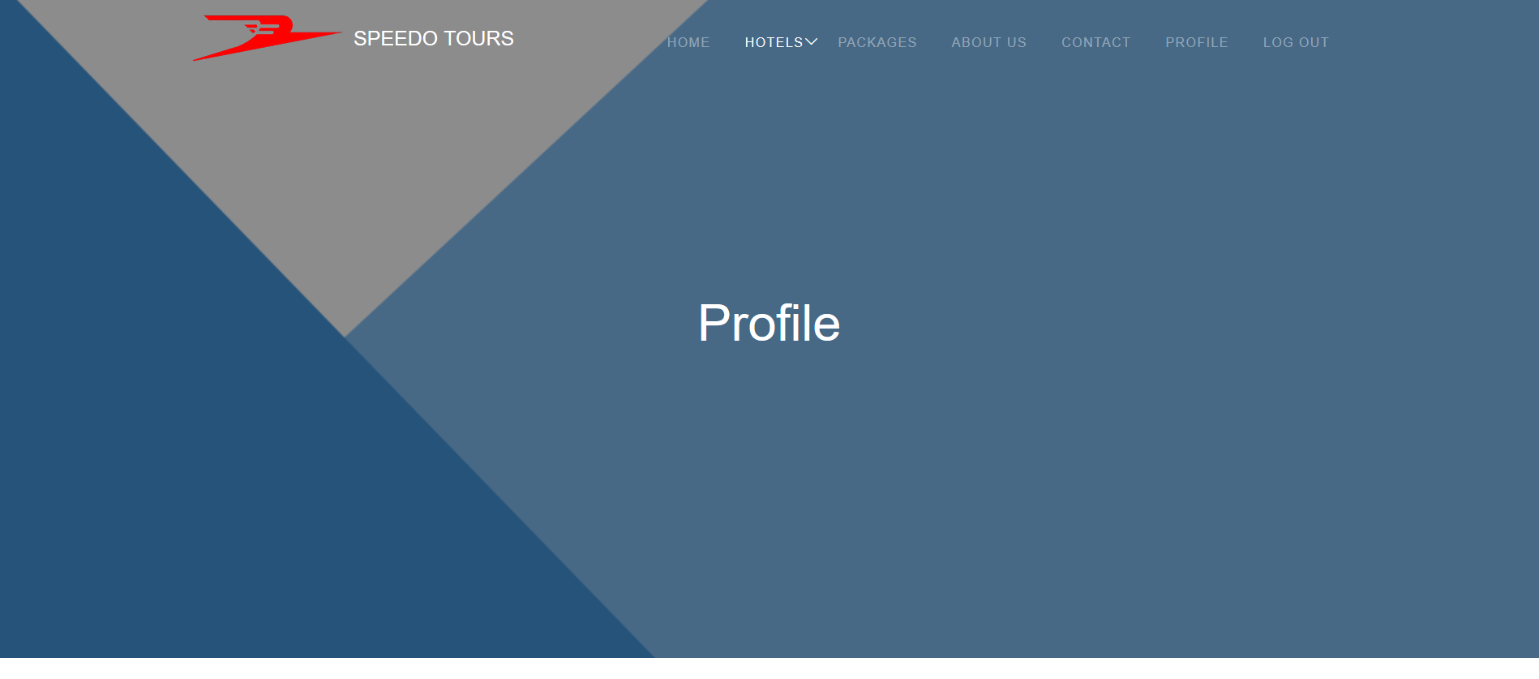
Frames (GUI)

Slide 23
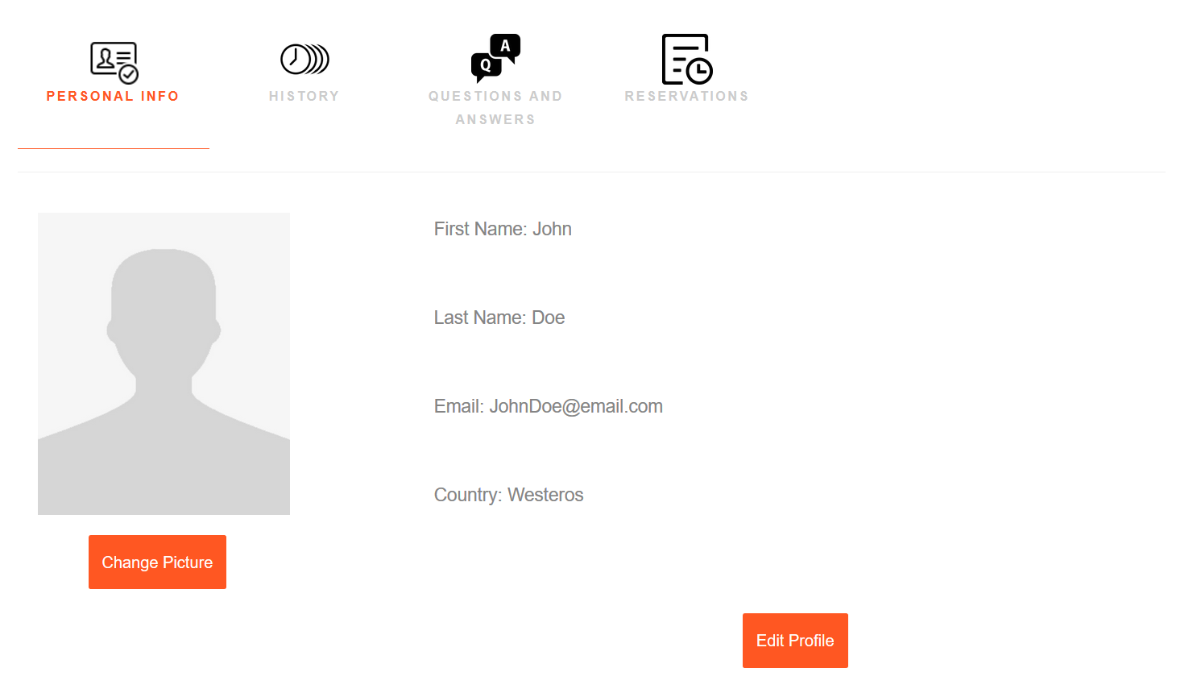
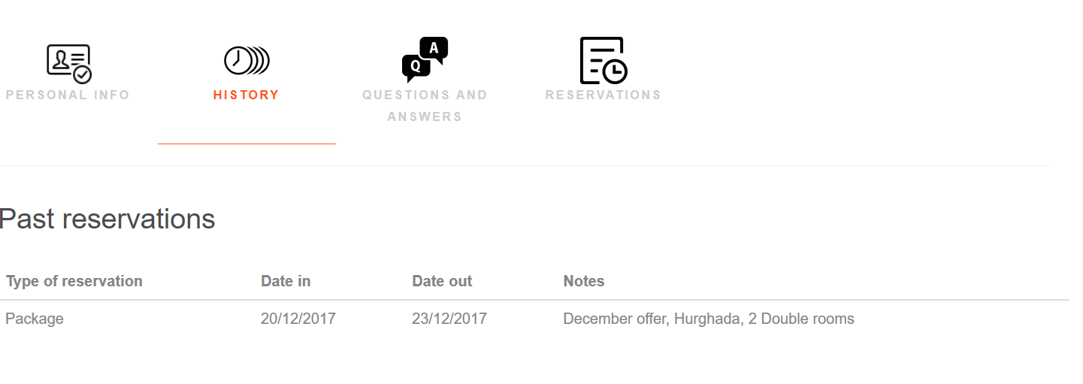
Frames (GUI)

Slide 24
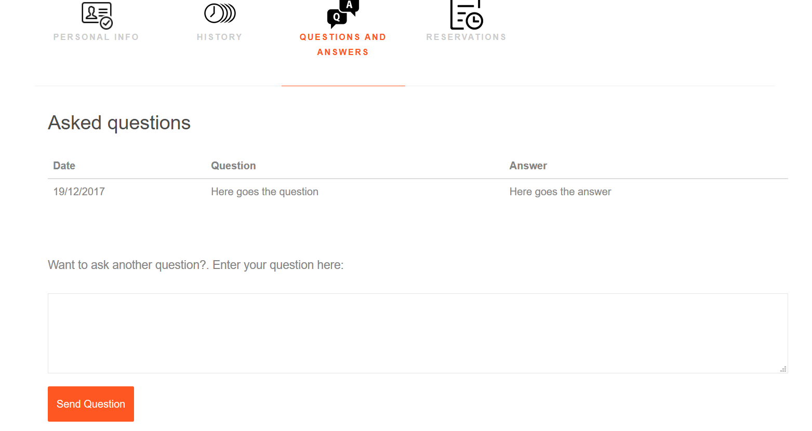
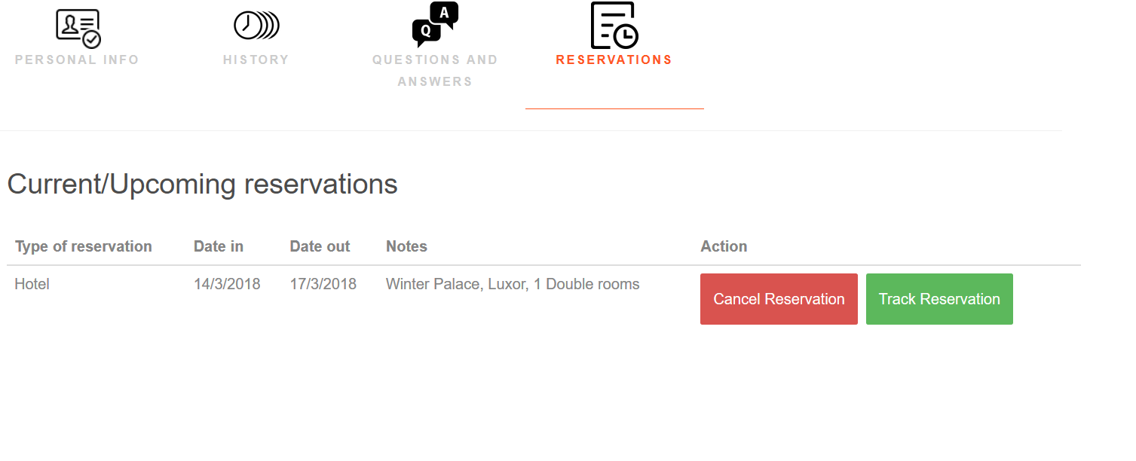
Frames (GUI)

Slide 25
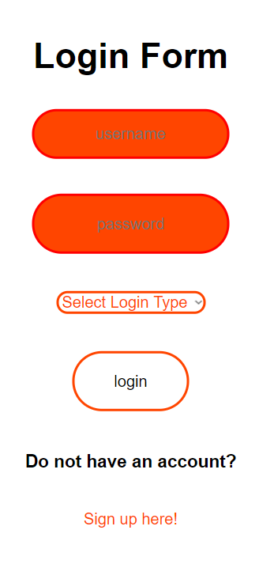
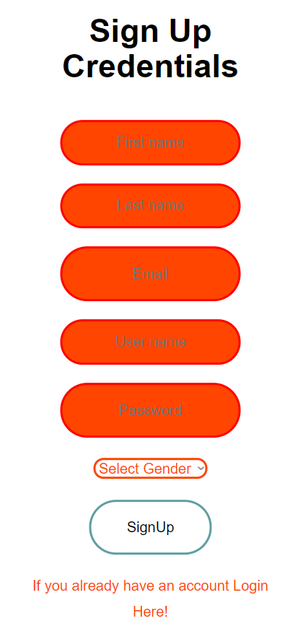
Frames (GUI)

Slide 26
THANK YOU
ANY MORE QUESTION ?

